Slide 1

Cloud 101
Basics of Using and Controlling Cloud Based Applications
  Dr. Alex Kilpatrick & Mary Haskett
  Tactical Information Systems

Slide 2
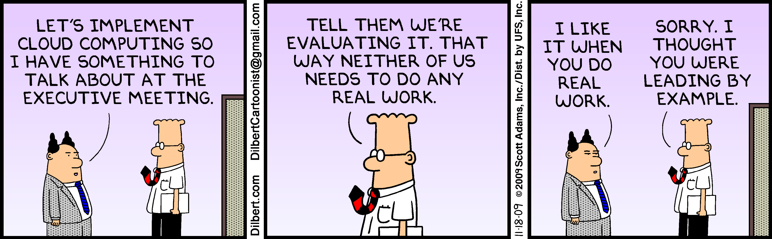

Slide 3
The National Institute of Standards and Technology (NIST) defines cloud computing as “a model for enabling convenient, on-demand network access to a shared pool of configurable computing resources (e.g., networks, servers, storage, applications, and services) that can be rapidly provisioned and released with minimal management effort or service provider interaction.”
All clear now?

Slide 4

Fundamentally, the cloud is simply:
computing as a utility

Slide 5
Topics
Introduction to the cloud
Types of cloud computing
Cloud providers
Pricing models
Using the cloud
Future

Slide 6
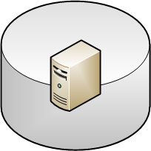
Virtualization
Started in 1967 with the IBM CP-40
Virtual machine (VM) software is a program that emulates a physical machine
A VM needs to act exactly like its physical machine
Key concept: A VM instance is simply a file that represents an actual machine and its state

Slide 7
Virtualization
Physical Machine
Virtual Machine
Virtual Machine
Virtual Machine
Virtual Machine
Virtual Machine
Virtual Machine

Slide 8
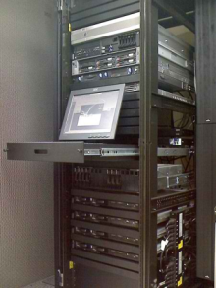
Related – Physical Hosting
Hosting is a way to share a high-bandwidth connection
You bring your own machine to the data center
  Physical security
  High bandwidth
  Someone to kick it for you
The company can also rent you a physical machine

Slide 9
Cloud History
“computation may someday be organized as a public utility” – John McCarthy, 1960
Amazon commoditized the cloud
  Realized that they typically only used 10% of the capacity
  (2009) Around 40,000 servers, 16 MW of power
  (2009) About $220M annually

Slide 10
Types of Clouds
Infrastructure as a service (IaaS)
  You rent a virtual server
  Amazon, Rackspace, GoGrid, etc.
Platform as a service (PaaS)
  You rent an abstract machine
  Google app engine, Salesforce, etc.
Software as a service (SaaS)
  You rent a capability
  Exchange hosting, Wordpress hosting, etc.

Slide 11
Common Themes
In all clouds, someone else is providing the physical machines
You aren’t concerned about power, bandwidth, maintenance, physical security, or (sometimes) scaling
You only pay for what you use
  Although you may pay to guarantee a level of availability

Slide 12
Infrastructure as a service
Renting a virtual machine

Slide 13

Key Concepts
You can’t tell if you are on a cloud machine or not
From the perspective of the software (or an admin), a cloud machine is identical* to a real machine
It has to be, or things might not run right
* Except licensing

Slide 14
Key Concepts 2
With a cloud, you don’t “own” a physical machine
  In fact, you don’t own a virtual machine either
You are renting some “slice” of a bigger physical machine
  But you shouldn’t think about the physical machine
The cloud provider guarantees you RAM and some level of performance

Slide 15
Cloud vs. Virtual Machine
If you run your own VM on your own hardware, you can idle it at no additional cost
This is not true of the cloud
  Your machine is either frozen (to a file), or running up the bill
  If it is running, it is using up RAM from a physical machine, along with some allocation of CPU

Slide 16




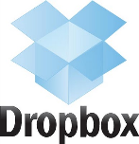
Applications
Application Hosting
Backup and Storage
Content Delivery
Databases
E-Commerce Applications
Enterprise IT
High Performance Computing
Media Hosting
On-Demand Workforce
Search Engine Applications
Web Hosting
Facebook Apps
Mobile Apps

Slide 17
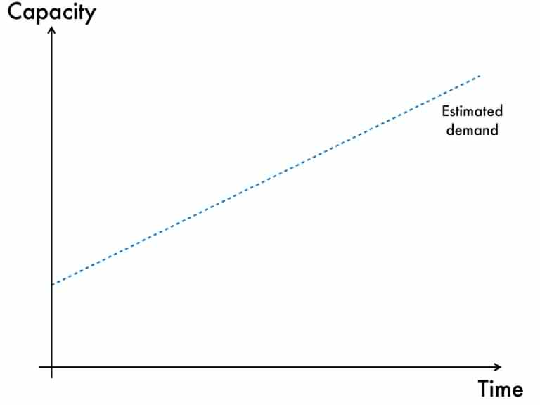
Source: http://www.slideshare.net/FDIHdk/ahead-in-the-cloud-matt-wood-amazon

Slide 18
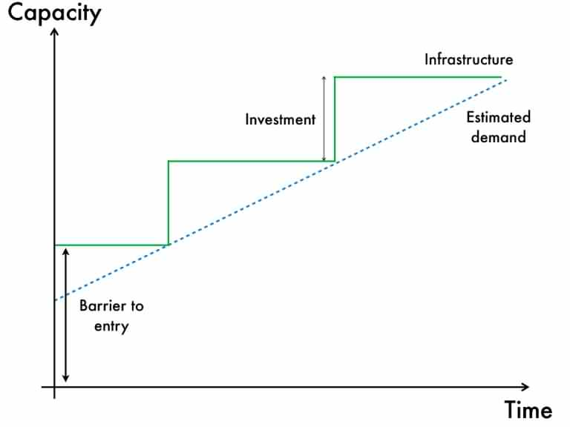
Source: http://www.slideshare.net/FDIHdk/ahead-in-the-cloud-matt-wood-amazon

Slide 19
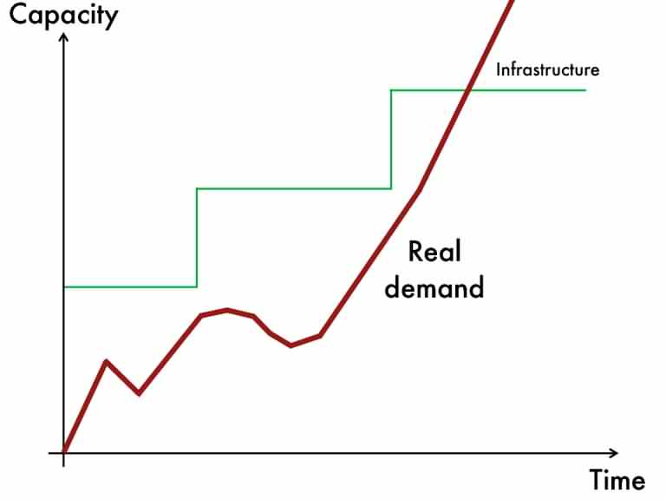
Source: http://www.slideshare.net/FDIHdk/ahead-in-the-cloud-matt-wood-amazon

Slide 20
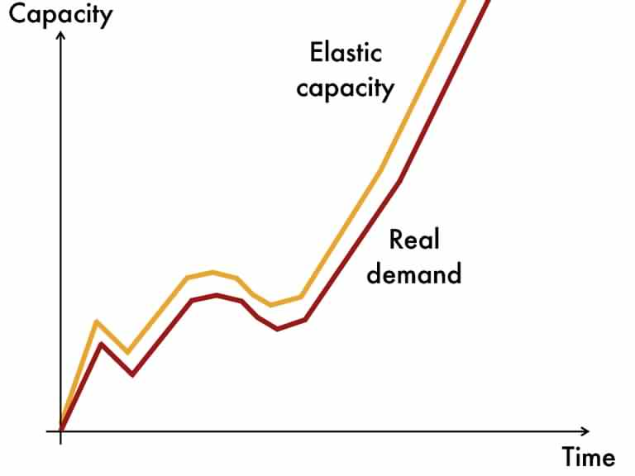
Source: http://www.slideshare.net/FDIHdk/ahead-in-the-cloud-matt-wood-amazon

Slide 21
Utility Paradigm
Let’s say you have a job that will take 10,000 hours of processing time
You can:
  Run 1 instance for 10,000 hours
  Run 100 instances for 100 hours
  Run 1000 instances for 10 hours
  Run 10,000 instances for 1 hour
All of these cost the same!

Slide 22
Key Steps
Determine your operating system
Determine how much computing you need
Find an instance in your cloud provider library of machines
Start an instance
Get coffee
Login to your instance remotely
Configure your server
???
Profit

Slide 23
Scalability
Vision: Automatically scale up / down machines as needed
Scalability does not come free, unfortunately!
You have to design it in your application
  Each instance has to start independently
  Data can’t be stored on each instance
Amazon EC2 can auto-scale, but your application has to support it

Slide 24

Instance vs Shared Data
Instance
Instance
Termination
Local Data
Local Data
Cloud Data
Cloud Data

Slide 25
Scalability
In
Web App
Web App
Web App
Back End
?
Web App
Back End
Back End
Database
Back End
Database
Database
Database
Instance 1
Instance 2
Instance 3
Instance 4

Slide 26
Scalability
Web App
Web App
In
Back End
Back End
Web App
Instance 1
Instance 2
Back End
Database
Web App
Database
Instance 4
Instance 1
Back End
Instance 3

Slide 27
Reliability
If the machine your instance lives on goes down, your instance is down
  Applications need to be architected to handle this
  Instances are usually ephemeral
  EC2 is 99.95% over 1 year period
Amazon’s storage is different
  99.999999999% durability over a year

Slide 28
Failures
April, 2011: Reddit, Foursquare, Quora (and many others) were down because of EC2 failure
  Netflix was unscathed because of replication (and chaos monkey)
Still some concerns about reliability
  But more reliable than most internal datacenters (& people)

Slide 29

Security
Ongoing concerns about security of the cloud
Partially based on the lack of physical control
The cloud provider does not have a master key to your server
  Access is generated from your own private key
Most providers support simple firewall type functions, but nothing complex*
* See Firehost for more security options

Slide 30
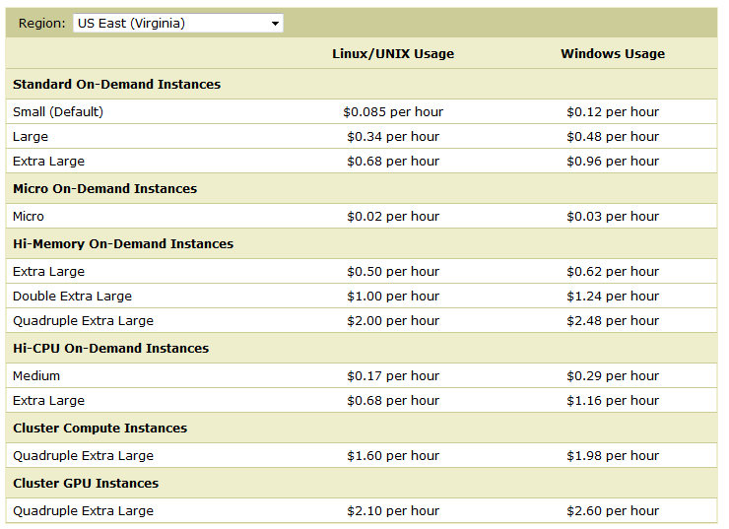
Pricing - Amazon

Slide 31
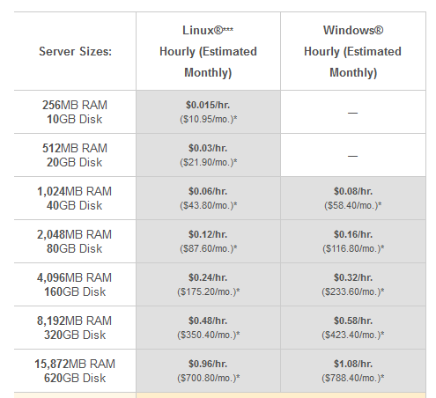
Pricing - Rackspace

Slide 32
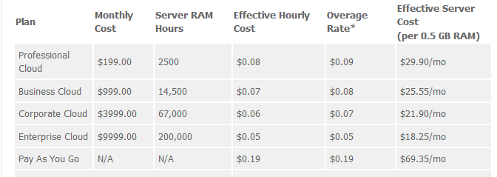
Pricing - GoGrid

Slide 33
About Pricing
Every vendor prices somewhat differently
  Difficult to compare, but prices are generally the same
Typical separate charge for all aspects
  Static IP
  Data transfer in/out
  Monitoring
  Storage

Slide 34
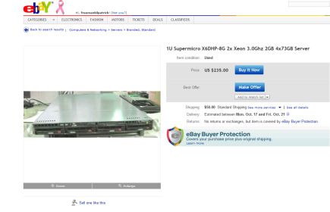
A Server Comparison
Options for a “garage” startup
  Amazon EC2 Small Instance
    ~$1200 / year + minimal bandwidth costs
  1U Rack Server from eBay
    $300 + $360/year for cable internet
The cloud is not automatically the best option

Slide 35
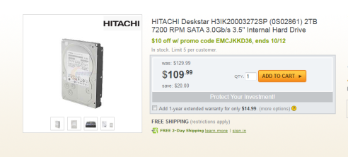
Storage Comparison
2 TB Hard Drive: ~$100
2 TB in EC2: $200 / month (!)
  .10 / GB / Month
  But all the Cloud data is completely available on the web.

Slide 36
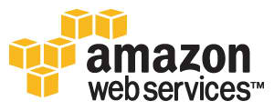
Amazon
Elastic Block Store – flexible, high-performance storage
Elastic Load Balancing – automatically direct traffic across servers
Cloud Watch – scaling and monitoring
Spot Instances – bid for space computing time
Relational Database Store – Big MySQL database
HADOOP – large data processing

Slide 37

Rackspace
Non-ephemeral instances
Large granularity of instances
Static IP address for instances
“Burstable” CPU
OpenStack for control

Slide 38




Others
Softlayer
  Supports “bare metal” instances
  First 2 TB / month is free
  Dedicated / cloud integration
Slicehost
  Bought by Rackspace
Firehost
  Focus on security
Linode
  Inexpensive
  Linux only

Slide 39
Hybrid Clouds
Use your own local infrastructure to save money, and “burst” to the cloud
Ideally, with same infrastructure
  Support from VMWare
  Eucalyptus – open source Amazon compliant cloud
Controversial – may be the worst of both worlds

Slide 40
Platform as a service
Renting an abstract machine

Slide 41
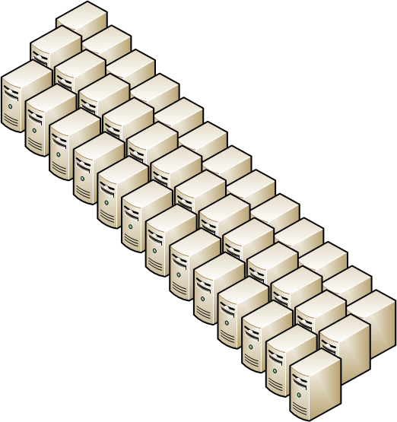
Concept
You have an (essentially) unlimited machine
  CPU resources scale up or down as needed
  No need to spin up new machines, manage load balancing, etc.
But there is a catch
You have to write your application according to their rules

Slide 42



Google App Engine
Automatic scaling, load balancing
Built-in support for email, Google authentication
Scheduled tasks & queues
Persistent storage
Program in Java, Go, or Python

Slide 43
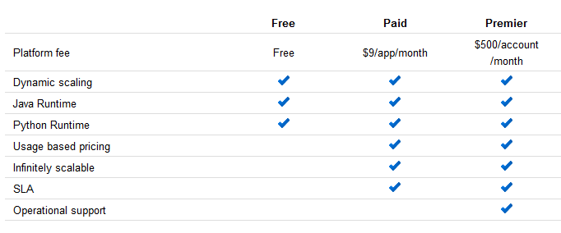
GAE Pricing

Slide 44
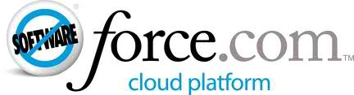
Force.com
Part of salesforce.com
PAAS optimized for business applications
Expensive per-user cost
Lock-in to vendor

Slide 45
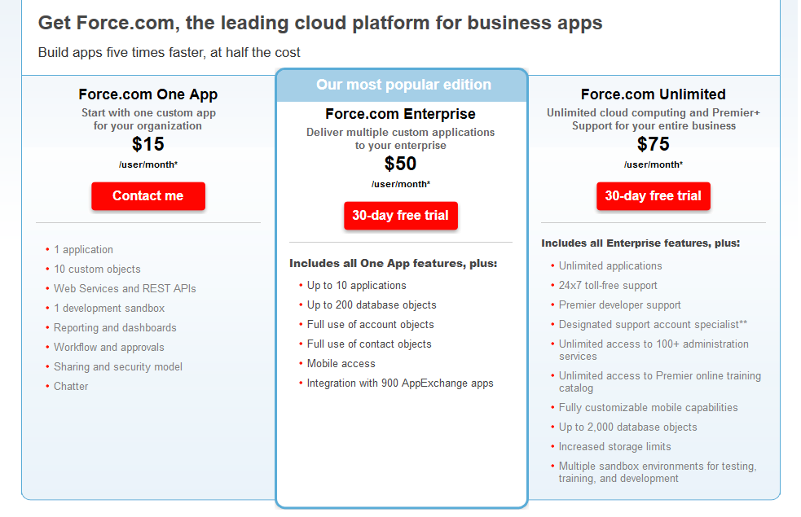
Force.com Pricing

Slide 46
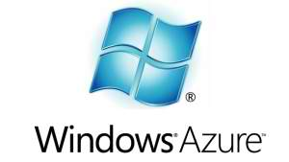
Windows Azure Platform
Runs on Microsoft Azure cloud platform
Supports .Net applications
Currently in limited production release

Slide 47
Software as a servicE
Renting software

Slide 48
Concept
Simply renting an application instead of setting it up on your own server
Examples:
  Exchange hosting ($10/user/month)
  Wordpress hosting ($20-$150 / month)
  Web hosting ($90 / year)
  Quickbooks ($50 / month)
  Salesforce ($125/user/month)
  World of Warcraft ($20/month)
These are all cloud apps (computing as a utility)

Slide 49
Controlling the cloud
The next level

Slide 50
Control
If you want more control, you need to use an Application Programmer Interface (API) to control your instances
Amazon’s API is proprietary
Rackspace founded the OpenStack API to develop a generic API across providers
Uses REST API, so can use any language you wish

Slide 51
Scenario
You develop a killer SaaS application
You want to give each user their own server
Your users sign up for your service on your website
After payment, you start up their server

Slide 52
Types of Operations
Create server
Get server details
Update user/password
Delete server
Reboot server
Rebuild server
Resize server
Get server addresses
Create server images
Start servers
Terminate servers
Control balancing
Provision storage
Store items
Delete items
Release storage

Slide 53
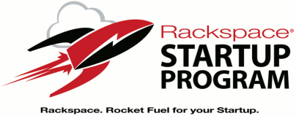

Getting Started
aws.amazon.com/free
Amazon Free Tier
  Linux only
  750 Hours
  “Micro” instance
  15 GB Bandwidth
  5 GB Storage
www.rackspacestartups.com
Rackspace Startup Program
  Up to $2500/month credit
  Automatic for major incubators
  Others can apply

Slide 54
Future
Increase in hybrid clouds
  Leveraging company’s desire to keep things in-house
  Synchronized solutions (e.g. Evernote)
Increase in PaaS
  iCloud, etc.
More movement to cloud in general
  Government mandates to reduce data centers
Reduced costs with competition

Slide 55
Thank You!
Alex Kilpatrick
alex@tacticalinfosys.com
@alexkilpatrick

